Slide 1
OLIST STORE ANALYSIS
Domain: E-Commerce

Slide 2
OBJECTIVES
Weekday Vs Weekend (order_purchase_timestamp) Payment Statistics
Number of Orders with review score 5 and payment type as credit card.
Average number of days taken for order_delivered_customer_date for pet_shop
Average price and payment values from customers of sao paulo city
Relationship between shipping days (order_delivered_customer_date - order_purchase_timestamp) Vs review scores.

Slide 3
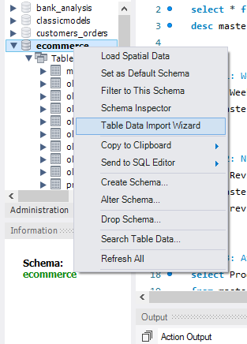
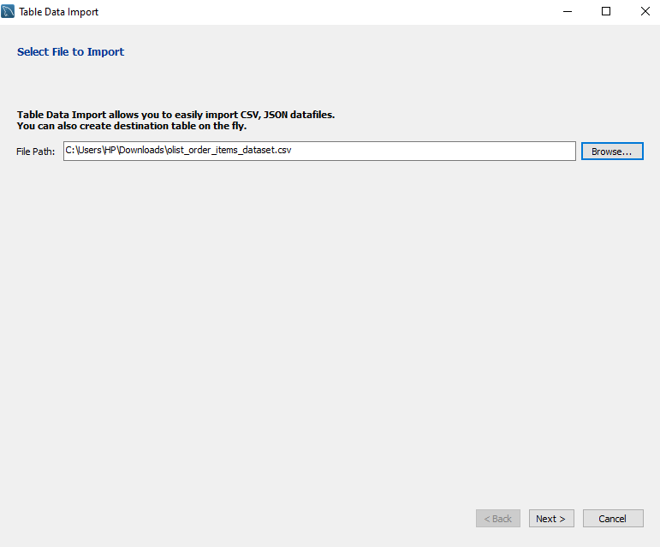
Data Import (csv to MySQL)

Slide 4
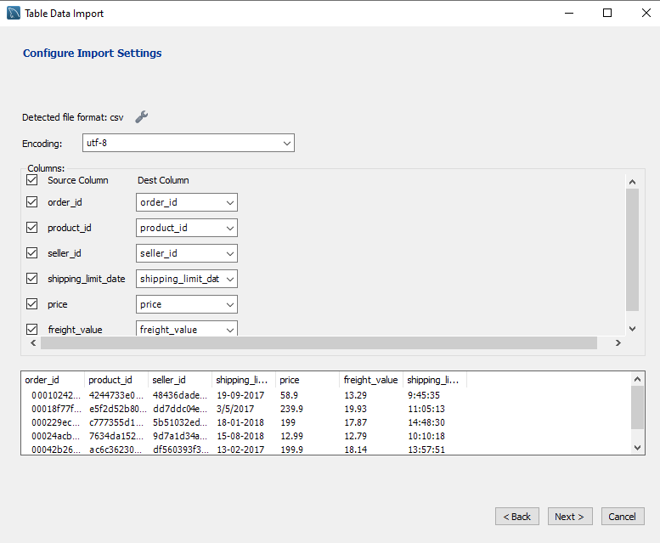
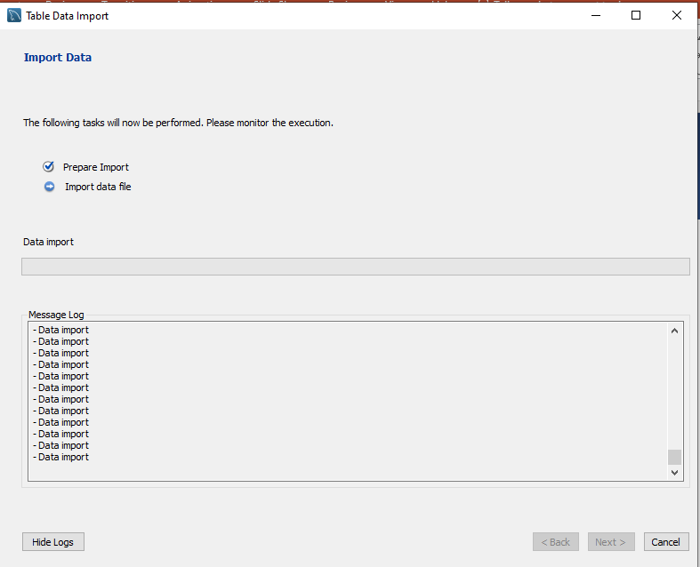

Slide 5
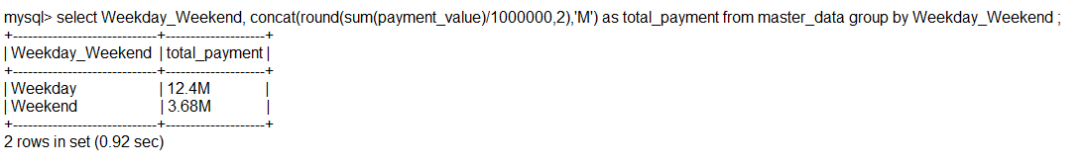
KPI 1- Weekday Vs Weekend (order_purchase_timestamp) Payment Statistics

Slide 6
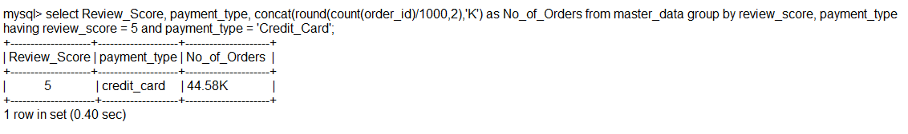
KPI 2- Number of Orders with review score 5 and payment type as credit card.

Slide 7
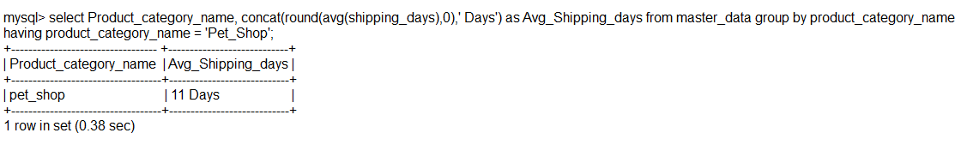
KPI 3 - Average number of days taken for order_delivered_customer_date for pet_shop

Slide 8
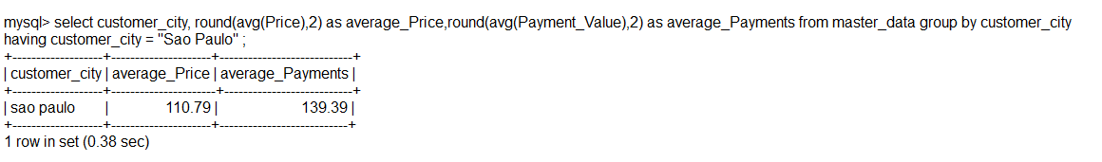
KPI 4 - Average price and payment values from customers of sao paulo city

Slide 9
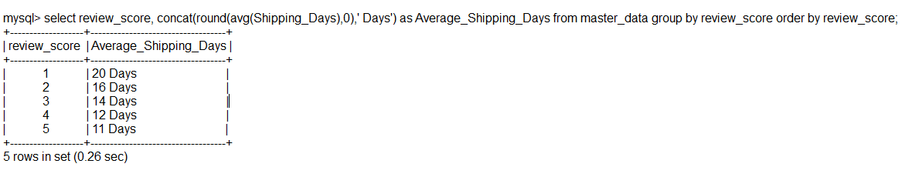
KPI 5 : Relationship between shipping days (order_delivered_customer_date - order_purchase_timestamp) Vs review scores.

Slide 10
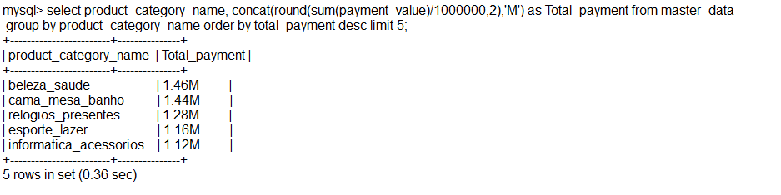
Top 5 Products by Payment

Slide 11
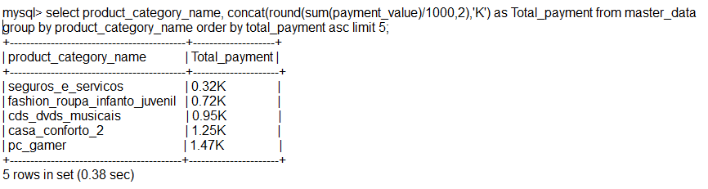
Bottom 5 Products by Payment

Slide 12
THANK YOU…

